Slide 1





SquadUp!
By Albert Fung and Jaron Martinez
Notes:
Go into process from where we were, to where we are

Slide 2


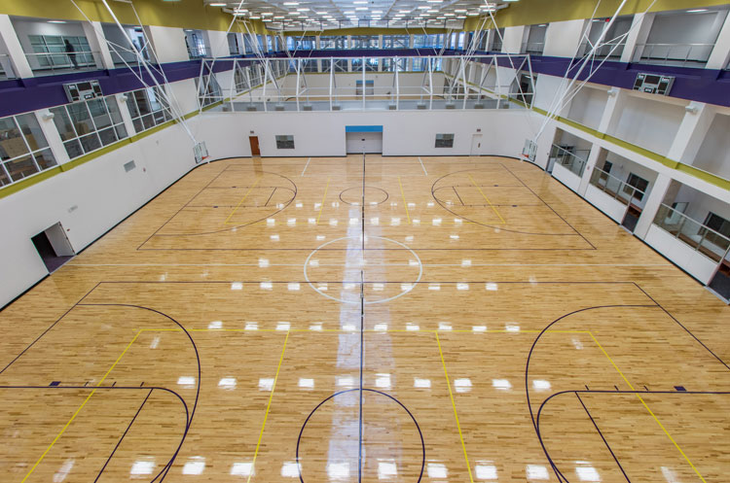
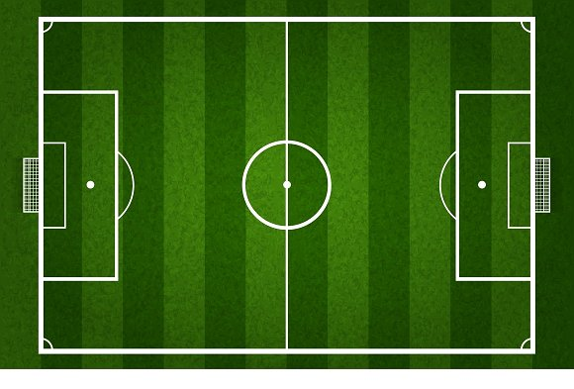
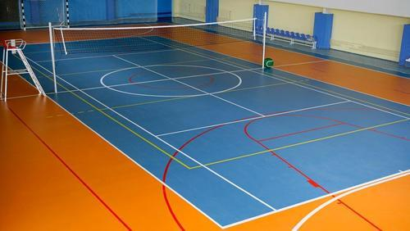
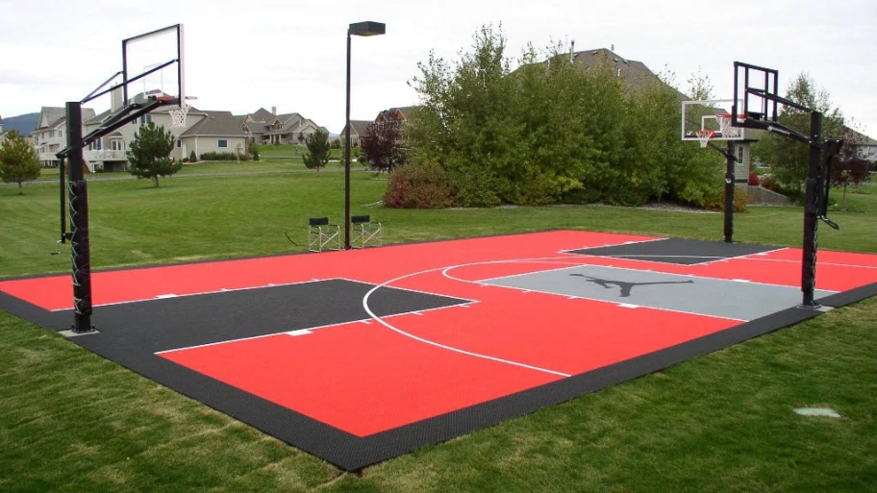
Intro
New to town?
Bored at home?
Need to meet new people?
Need more competition?

Slide 3

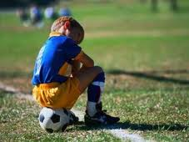
Problem
:
Don’t know where to play?
Too many people to get a good sweat going?
Not enough competitive play?

Slide 4

Solution
Create an app that can match individuals to play in teams

Slide 5
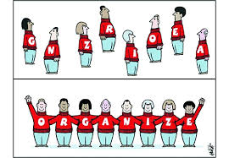
Solution Explained
Request to add registered friends so you can start up a team before leaving the house.
Get notifications
Organize tournaments
Check court traffic/volume/competition level
You can rate players on your team based on performance

Slide 6
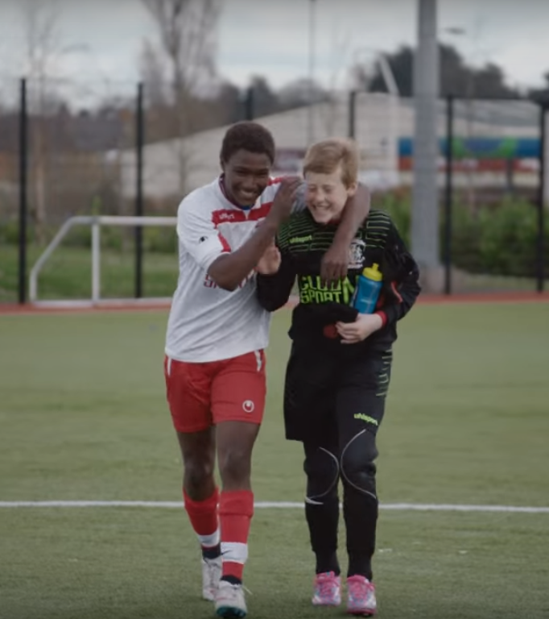
How does the app work?
Create a profile
Go to nearby courts/fields
Play with other athletes
Rate courts
Rate other players

Slide 7
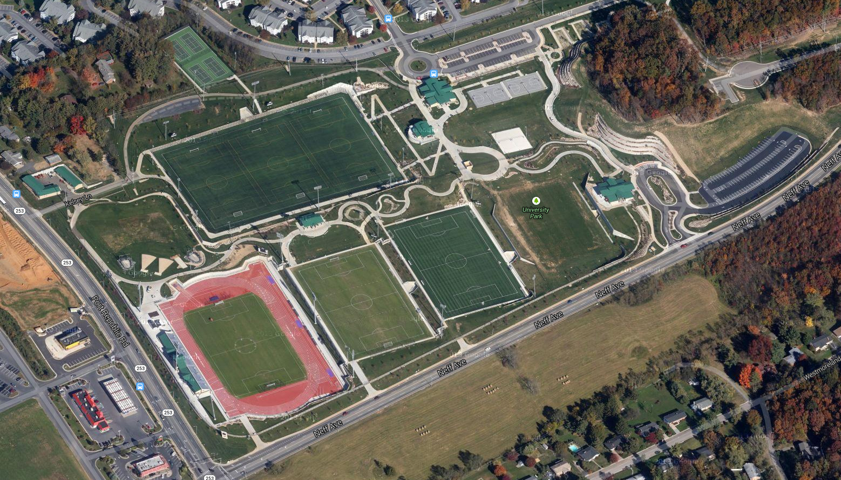
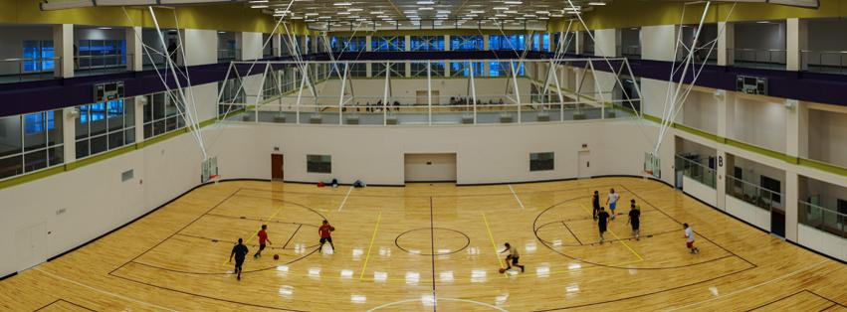
Resources
UREC
UPARK
Off-campus Housing Courts

Slide 8


Target audience
Students
17-32
Men

Slide 9



Compare with other apps
Quotes for illustration purposes only

Slide 10
Conclusion
Next Steps:
Spread Awareness
Updates
Expand

